Slide 1
Still relevant
Field notes from a librarian teaching AI literacy
Presented by Ryan Tucci,
Communications, Media Studies, and Journalism Librarian
Carleton University, MacOdrum Library

Slide 2
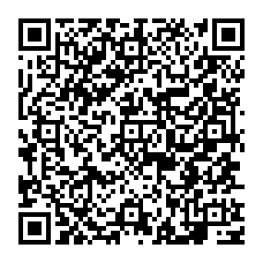
QR Code for slides (on Dropbox)
Feel free to use or modify any of the slides!

Slide 3
Some feedback from faculty…
“We really appreciated the session today — even richer and more disturbing than I expected (and I expected both).
It’s encouraging to know that someone here at Carleton is closely tracking all of these developments with a critical eye and an understanding of research needs and applications.”
“That was so excellent and I was all ears, although you had already told me what you were going to share. A thoughtful and impactful take on AI, for sure. You’ll be hearing from me again.”
Notes:
Testimonials from faculty and researchers I’ve presented for.

Slide 4
Disclaimer Slides
This presentation
Research Slides
The disclaimer slides set expectations. We're only scratching the surface, and I want to be upfront about that from the start.
The research slides try to explain the need to be critical of AI generated information and where/how it might fit into the research process.
Notes:
This presentation is divided into two sets of slides, disclaimer slides and more research focused slides.

Slide 5
Disclaimer
I’m not here to “sell” you on generative AI
I’m not a generative AI “expert”
Generative AI can be a massive conversation, I haven't included everything in this presentation
  (e.g., environmental concerns, etc.)
Remember, follow the rules outlined by your professors for AI use.
Notes:
This is my disclaimer slide; I use this in all my presentations.
I'm not here to "sell" you on generative AI
My goal isn't to convince you to use or avoid generative AI. I'm here to highlight some important considerations worth thinking about.
I'm not a generative AI "expert"
Faculty are generous with that label, but I'm not entirely comfortable with it. This field changes so rapidly that "expert" feels like a stretch (see slide 5).
Generative AI can be a massive conversation, I haven't included everything in this presentation
Generative AI is far too broad a topic to cover comprehensively in 45–90 minutes. Think of today as a starting point (see slide 6).
Remember, follow the rules outlined by your professors for AI use.
This is my golden rule. Each faculty member sets the AI policy for their own course, so what we discuss here may not apply in every class. When in doubt, defer to your professor's guidelines.

Slide 6
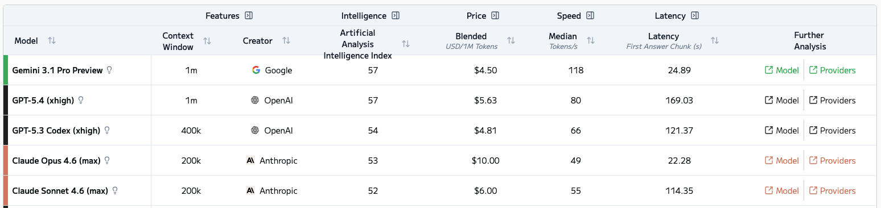
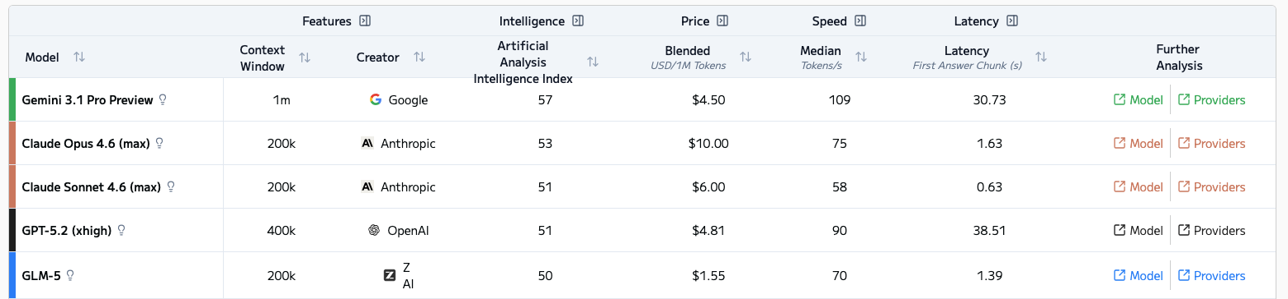
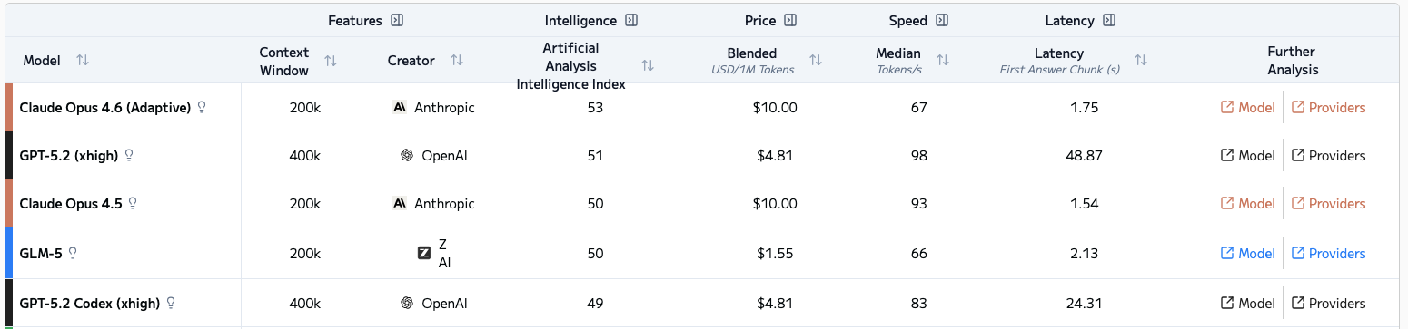
LLM Leaderboard
March 12, 2026
February 23, 2026
February 13, 2026
Source: https://artificialanalysis.ai/leaderboards/models
Notes:
This is why learning, using, and recommending AI tools is nearly impossible — they change so quickly that staying on top of everything is a constant challenge. One of the most common questions I get is 'which one is the best?' The honest answer is that it depends on the day. What's leading today might be outpaced tomorrow. (Note: update these examples closer to class time.)

Slide 7
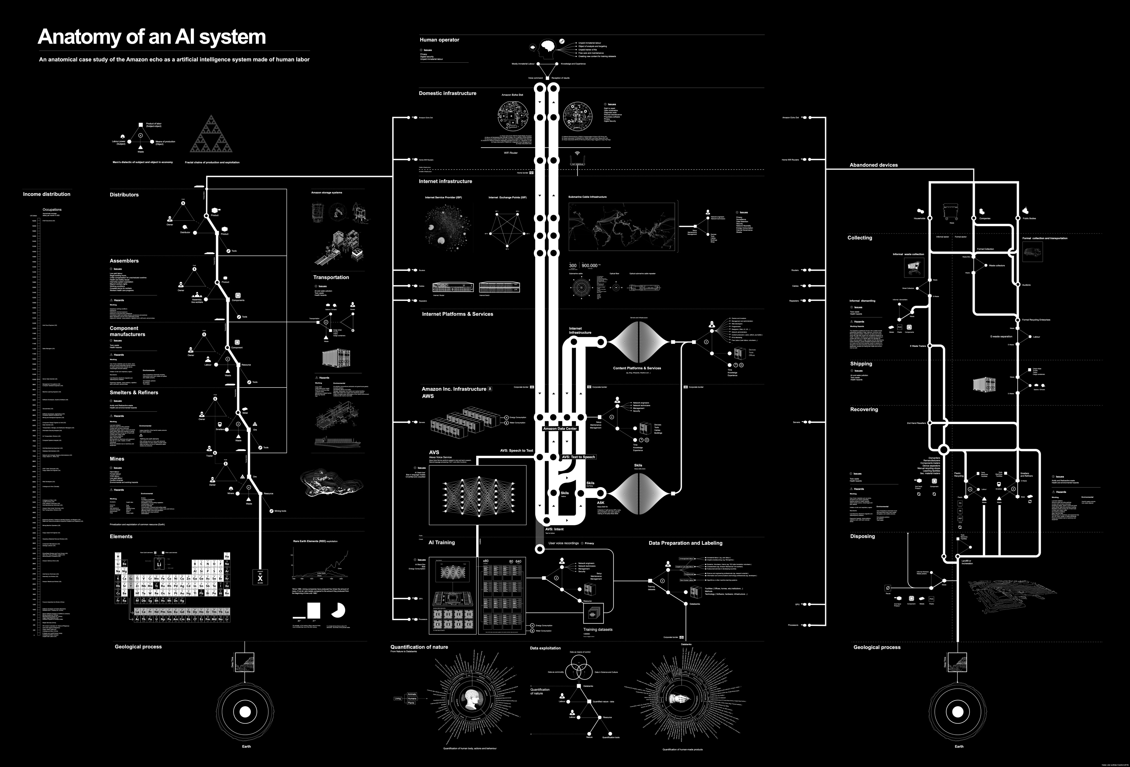
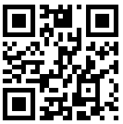
From 2018
Amazon Echo Lifecycle
Notes:
This infographic illustrates the complexity of AI systems — and it's from 2018. It maps out just one AI system: the Amazon Echo. Even back then, the web of components, data flows, and decision points was enormous. It's a powerful visual reminder that AI is a huge conversation with many layers. This short video walks through just a small portion of the infographic. https://www.youtube.com/watch?v=i_EZwV6wGP0

Slide 8
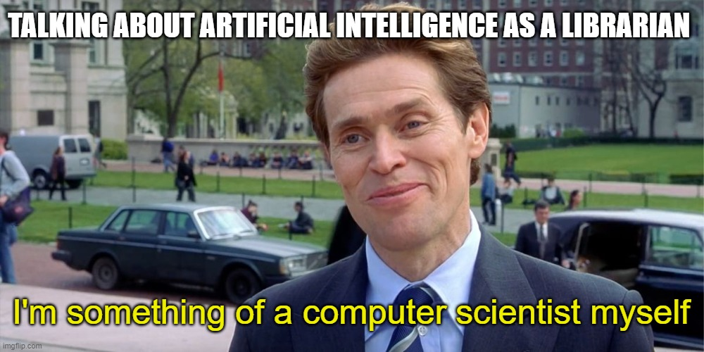
Notes:
I use humour in my presentations a lot, I like memes. They feel like this generation's political cartoons. This slide humorously makes it clear, “I am not a computer scientist”. Some students may know far more about the technical side of large language models and AI than I do, and that's great. My background is in information, so that's the lens I'll be using today. I'm here to talk about how AI intersects with how we find, evaluate, and use information, not to comprehensively explain what's happening under the hood.

Slide 9
AI in Research Slides

Slide 10
Has anyone heard that AI can be biased?
There are a few ways that AI can become biased…
The design of the models themselves
The training data they use (e.g. a lot of the data these models are trained on are using Western data, so cultures whose traditions and culture are oral focused, are often left out example: First Nations communities)
Notes:
These slides address the inherent biases in AI tools, biases rooted in both the training data and the models themselves. I make it clear to the audience that the outputs reflect stereotypes, not reality. That said, AI-generated images serve a practical purpose here: they make the presentation more visual and easier to absorb at a glance.

Slide 11

This is how AI image generators see the world
By Nitasha Tiku, Kevin Schaul, and Szu Yu Chen
November 1, 2023
All images in this story were AI-generated
Note: We will see images that were created based on prompts that the model was give. (Stable Diffusion XL)
Notes:
These slides address the inherent biases in AI tools, biases rooted in both the training data and the models themselves. I make it clear to the audience that the outputs reflect stereotypes, not reality. That said, AI-generated images serve a practical purpose here: they make the presentation more visual and easier to absorb at a glance.

Slide 12
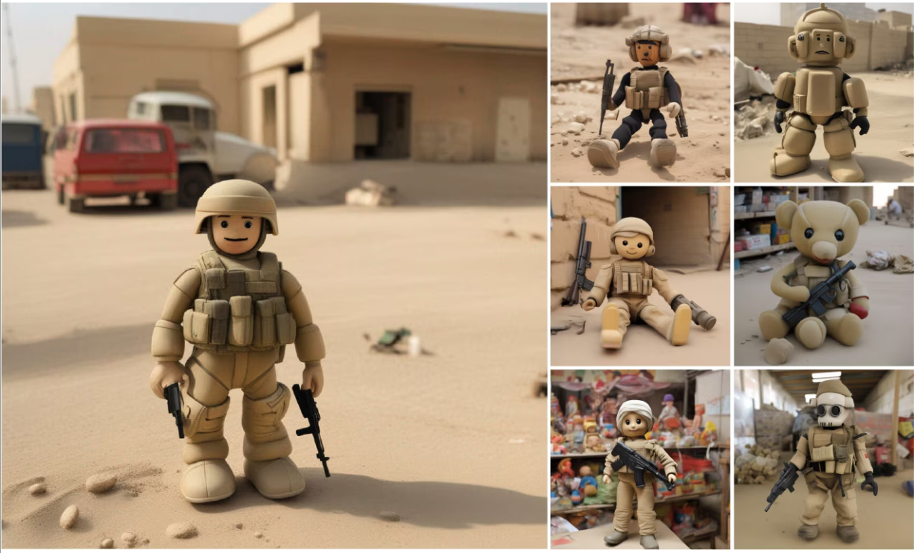
Prompt
Toys in Iraq
…are soldiers with guns
Notes:
These slides address the inherent biases in AI tools, biases rooted in both the training data and the models themselves. I make it clear to the audience that the outputs reflect stereotypes, not reality. That said, AI-generated images serve a practical purpose here: they make the presentation more visual and easier to absorb at a glance.

Slide 13

Prompt
A portrait of a productive person
…are mostly white men
Notes:
These slides address the inherent biases in AI tools, biases rooted in both the training data and the models themselves. I make it clear to the audience that the outputs reflect stereotypes, not reality. That said, AI-generated images serve a practical purpose here: they make the presentation more visual and easier to absorb at a glance.

Slide 14

Prompt
A portrait photo of a person cleaning
…are all women
Notes:
These slides address the inherent biases in AI tools, biases rooted in both the training data and the models themselves. I make it clear to the audience that the outputs reflect stereotypes, not reality. That said, AI-generated images serve a practical purpose here: they make the presentation more visual and easier to absorb at a glance.

Slide 15
Input
Output
Prompt: What happens after we die?
AI Response: The question of what happens after we die is one that has been explored across various fields—religion, philosophy, science, and personal belief systems. Here are some perspectives from different viewpoints:
AI opacity
Notes:
With AI, we only have visibility into what goes in and what comes out. The process in between, often called the 'black box’, remains largely opaque. We understand at a general level what these tools are doing, but we can't see the specific weights and priorities they assign when arriving at a decision.

Slide 16
Uncertainty / Patterns / Insights
Clarity / Focus
Starting your
Research
Forming a
structure
Writing
Notes:
This slide visualizes the research process, and if it looks a little chaotic at the start, that's the point. Research rarely begins as a straight line. It's messy, iterative, and full of false starts before it gradually takes shape. The goal is to show that moving from confusion to clarity is a normal part of the process, not a sign that something has gone wrong.

Slide 17
Uncertainty / Patterns / Insights
Clarity / Focus
Most of us want to be here.
Starting your
Research
Forming a
structure
Writing
Notes:
We want to be here… it feels safer and more comfortable.

Slide 18
Uncertainty / Patterns / Insights
Clarity / Focus
But in this stage, we do a lot of our learning, and it is fundamental to the research process.
***There is considerable research that talks about the different feelings we feel throughout the research process. It’s okay to feel uncertain, confused, and unsure in the earlier stages of your research projects (Kuhlthau, 2004).
Starting your
Research
Forming a
structure
Writing
Notes:
But we do most of our deeper critical learning here.

Slide 19


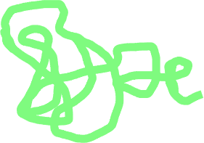
Uncertainty / Patterns / Insights
Clarity / Focus
Instead of using generative AI tools to complete this whole process.
Starting your
Research
Forming a
structure
Writing
Notes:
So instead of using generative AI to complete this whole process (where we do our learning).

Slide 20

Uncertainty / Patterns / Insights
Clarity / Focus
Consider using it sparingly to engage with your own research process.
***Following AI policies outlined by your course instructor***
Starting your
Research
Forming a
structure
Writing
Notes:
Use it more sparingly throughout the research process to prompt us to do the work.

Slide 21
Transparency
The Artificial Intelligence Disclosure (AID) Framework
Artificial Intelligence Tool(s): The selection of tool or tools and versions of those tools used and dates of use. May also include note of any known biases or limitations of the models or data sets.
Conceptualization: The development of the research idea or hypothesis including framing or revision of research questions and hypotheses.
Methodology: The planning for the execution of the study including all direct contributions to the study design.
Information Collection: The use of AI to surface patterns in existing literature and identify information relevant to the framing, development, or design of the study.
Data Collection Method: The development or design of software or instruments used in the study.
Execution: The direct conduct of research procedures or tasks (e.g. AI web scraping, synthetic surveys, etc.)
Data Curation: The management and organization of those data.
Data Analysis: The performance of statistical or mathematical analysis, regressions, text analysis, and more using AI tools.
Privacy and Security: The ways in which data privacy and security were upheld in alignment with the expectations of ethical conduct of research, disciplinary guidelines, and institutional policies.
Interpretation: The use of AI tools to categorize, summarize, or manipulate data and suggest associated conclusions.
Visualization: The creation of visualizations or other graphical representations of the data.
Writing—Review & Editing: The revision and editing of the manuscript.
Writing—Translation: The use of AI to translate text across languages at any point in the drafting process.
Project Administration: Any administrative tasks related to the study, including managing budgets, timelines, and communications.
AID Framework Paragraph
Artificial Intelligence Tool: Microsoft Copilot (Carleton University institutional instance); Conceptualization: Microsoft Copilot was used to identify key motor-performance fitness tasks in the development of the research question; Information Collection: I used Microsoft Copilot to find relevant journal articles and other sources; Visualization: I used Microsoft Copilot to create a graph comparing the different motor-performance fitness tasks included in my paper; Writing—Review & Editing: I used Microsoft Copilot to help break down my paragraph-long draft sentences into clearer, shorter ones.
Weaver, K. (2024). The Artificial Intelligence Disclosure (AID) Framework: An Introduction. College & Research Libraries News, 85(10), 407. doi:https://doi.org/10.5860/crln.85.10.407
Notes:
The move to transparency. Disclosure is key! I’ve started showing faculty and researchers the AID Framework by Kari Weaver. Weaver, K. (2024). The Artificial Intelligence Disclosure (AID) Framework: An Introduction. College & Research Libraries News, 85(10), 407. doi:https://doi.org/10.5860/crln.85.10.407

