Slide 1
Creating Space for Questions
Lessons from an AI Drop-In Session at the Library

Slide 2
RATIONALE
Students are using GenAI widely, but many still have important questions.
GenAI use is growing, but uncertainty around ethical and effective use remains.
Students need space to ask honest questions about GenAI without fear of judgment.
The library offers a neutral space for students to explore GenAI questions openly.

Slide 3
RATIONALE
Meet them where they are!

Slide 4
TIME AND LOCATION
Thursday, April 2nd, 10 am - 3 pm at the FSS Library.
(Right before Good Friday)
PARTICIPANTS
15

Slide 5
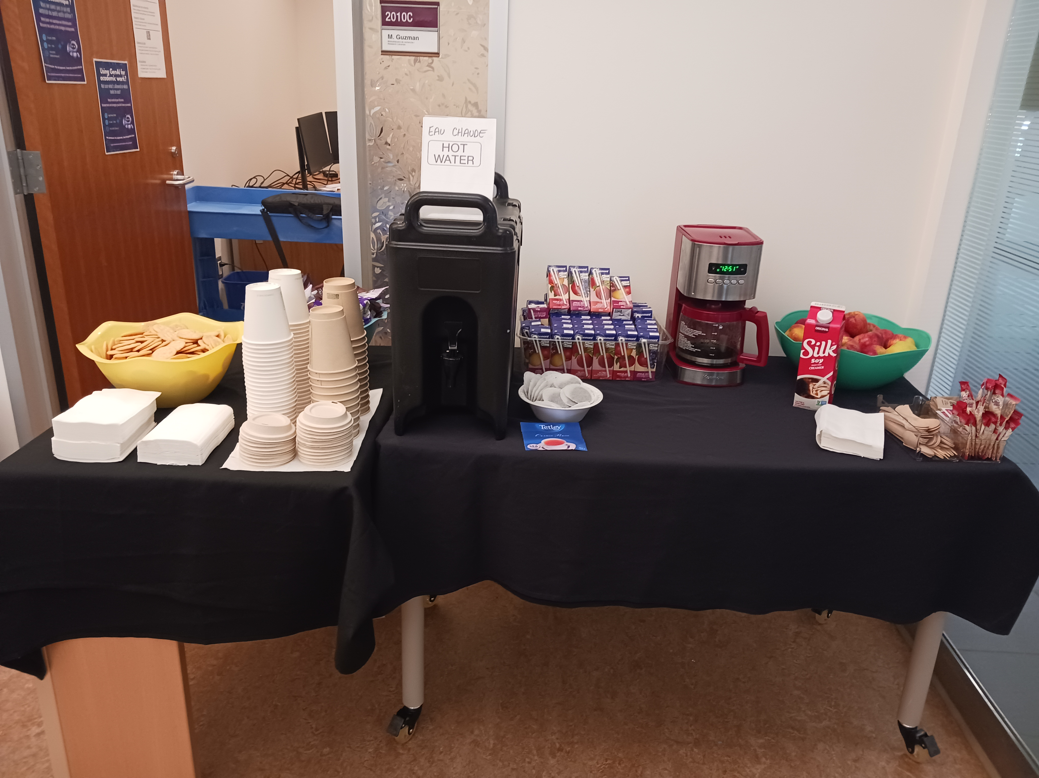
BUDGET

Slide 6
LIBRARIANS INVITED
Thomas Rouleau (Copyright Librarian)
Emma Garlock (Research Librarian (Health Sciences and Medicine)
Peter Farrell (Research Librarian (Science and Engineering)
Mathieu Cloutier (Digital Literacy Librarian)

Slide 7
  A Survey (FR & EN, Online & Paper Copies, Tim Hortons Gift Card)
  Reference sheets about the platforms available for testing: Scopus AI, WoS AI Research Assistant, Microsoft Copilot, Research Rabbit, Elicit and Notebook LM
MATERIALS & ACTIVITIES
  A list of topics for students to test the tools (FR & EN)
  A whiteboard activity, but we only collected 1 note

Slide 8
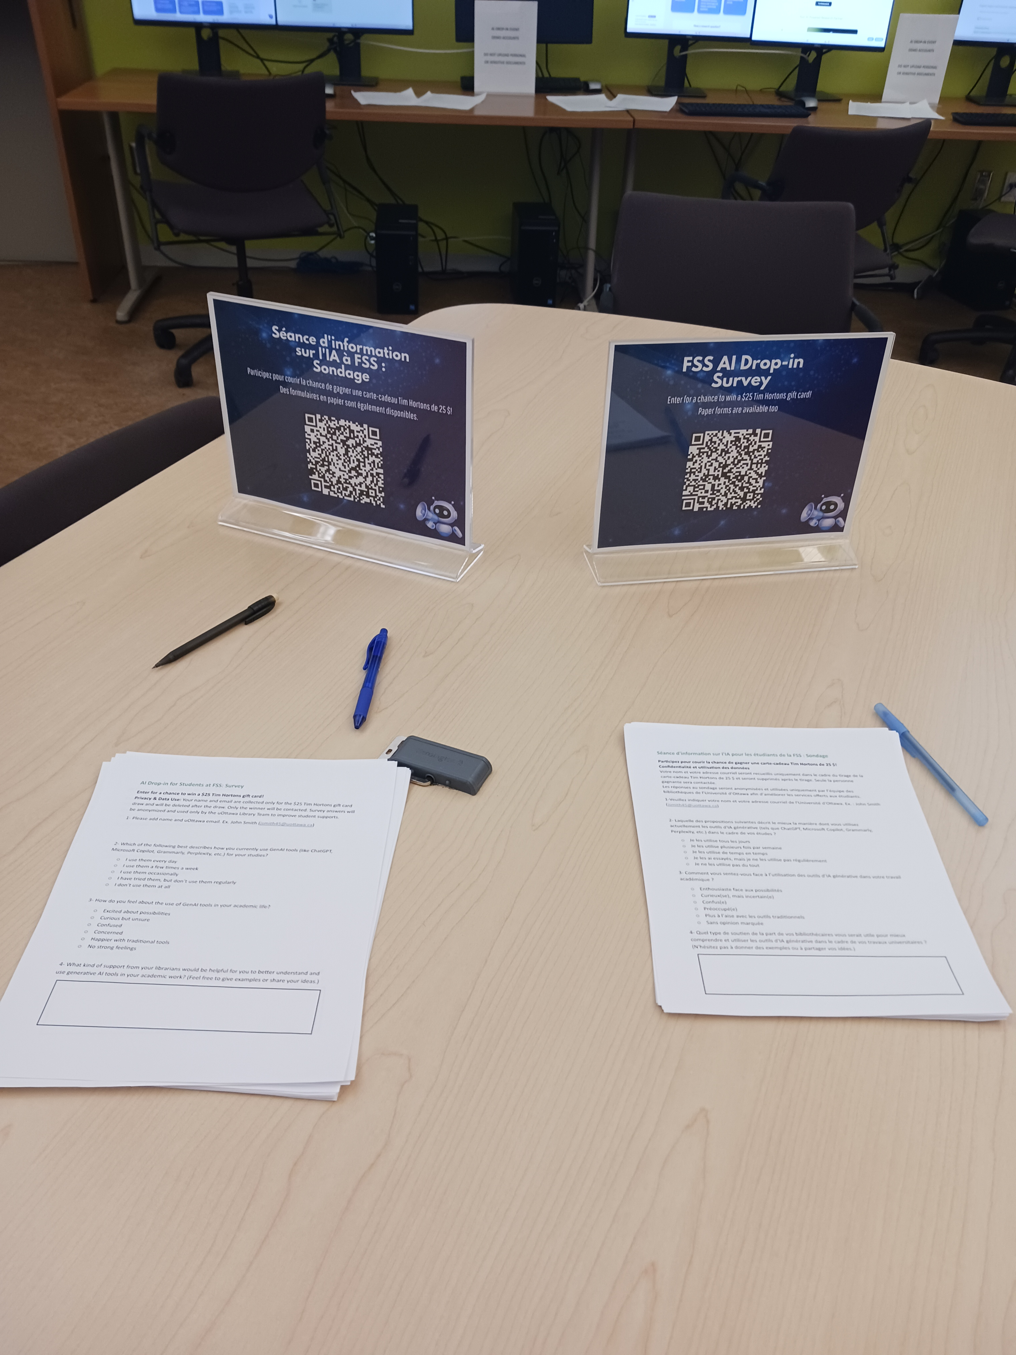
  A Survey (FR and En, Online and Paper Copies, Tim Hortons Gift Card)
MATERIALS & ACTIVITIES

Slide 9
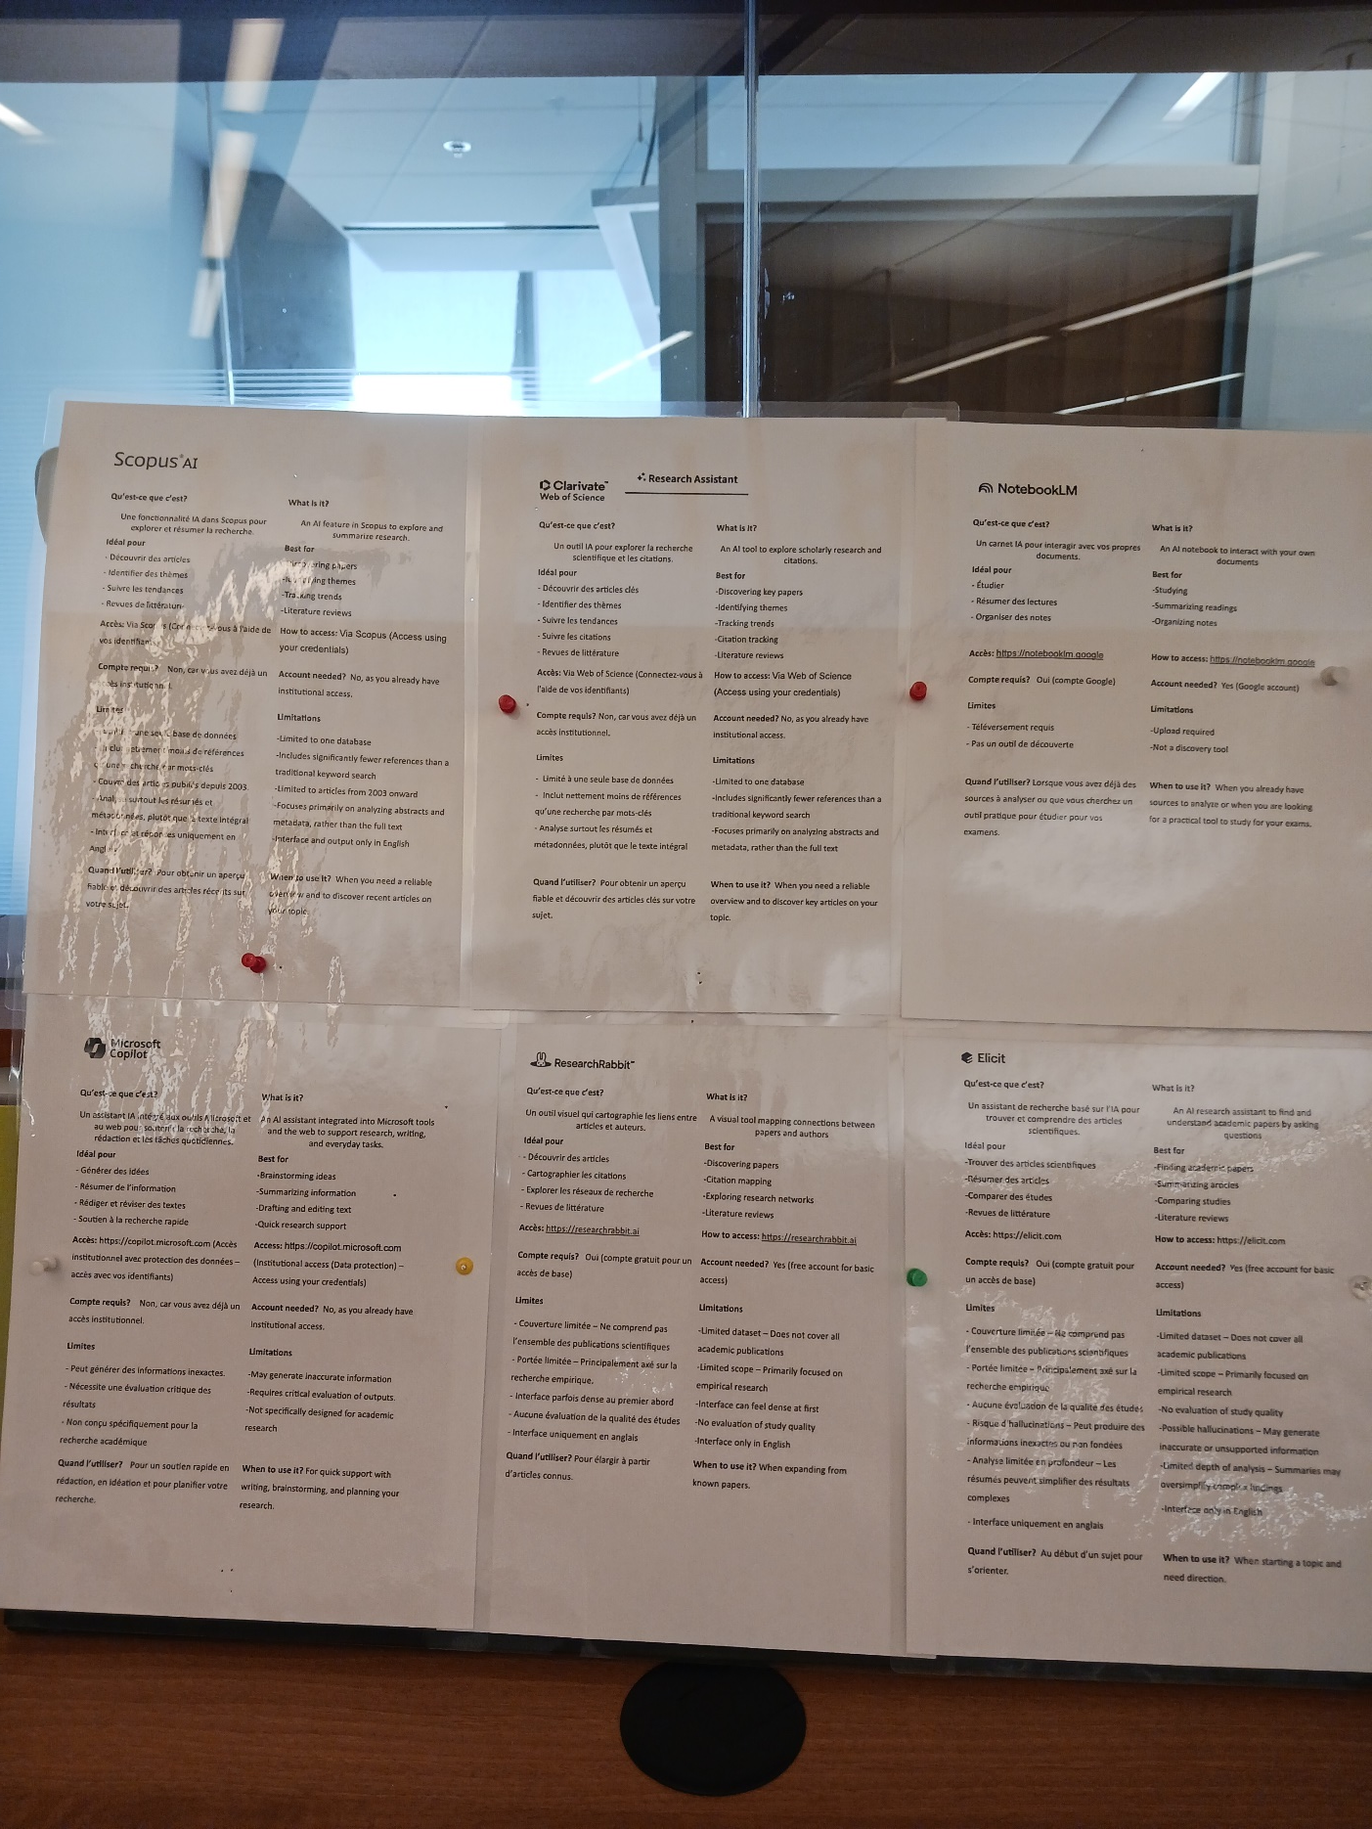
  Reference sheets
MATERIALS & ACTIVITIES

Slide 10
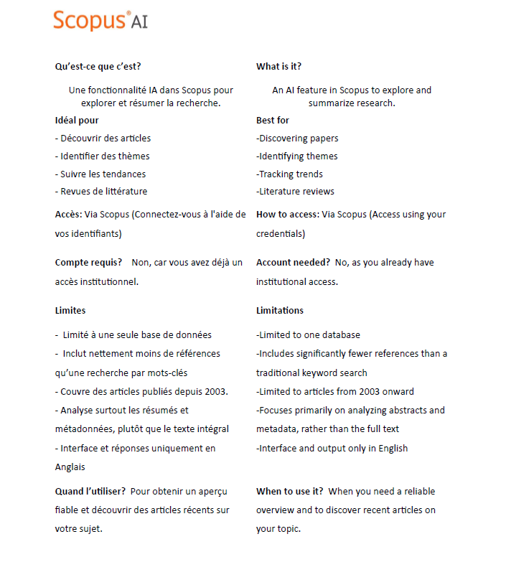
  Reference sheets
MATERIALS & ACTIVITIES

Slide 11
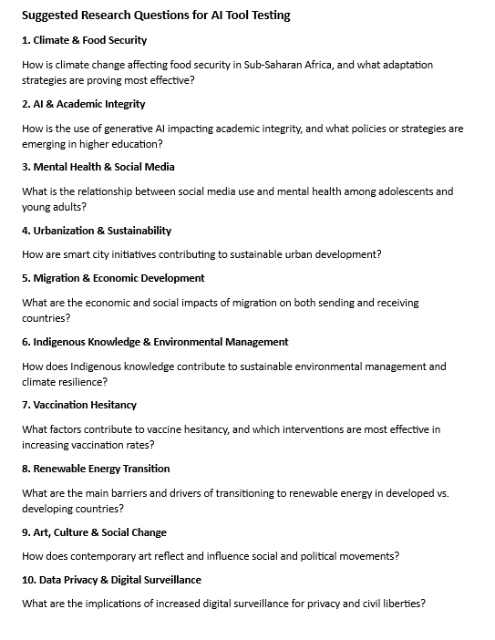
  List of topics for students to test the tools (FR & EN)
MATERIALS & ACTIVITIES

Slide 12
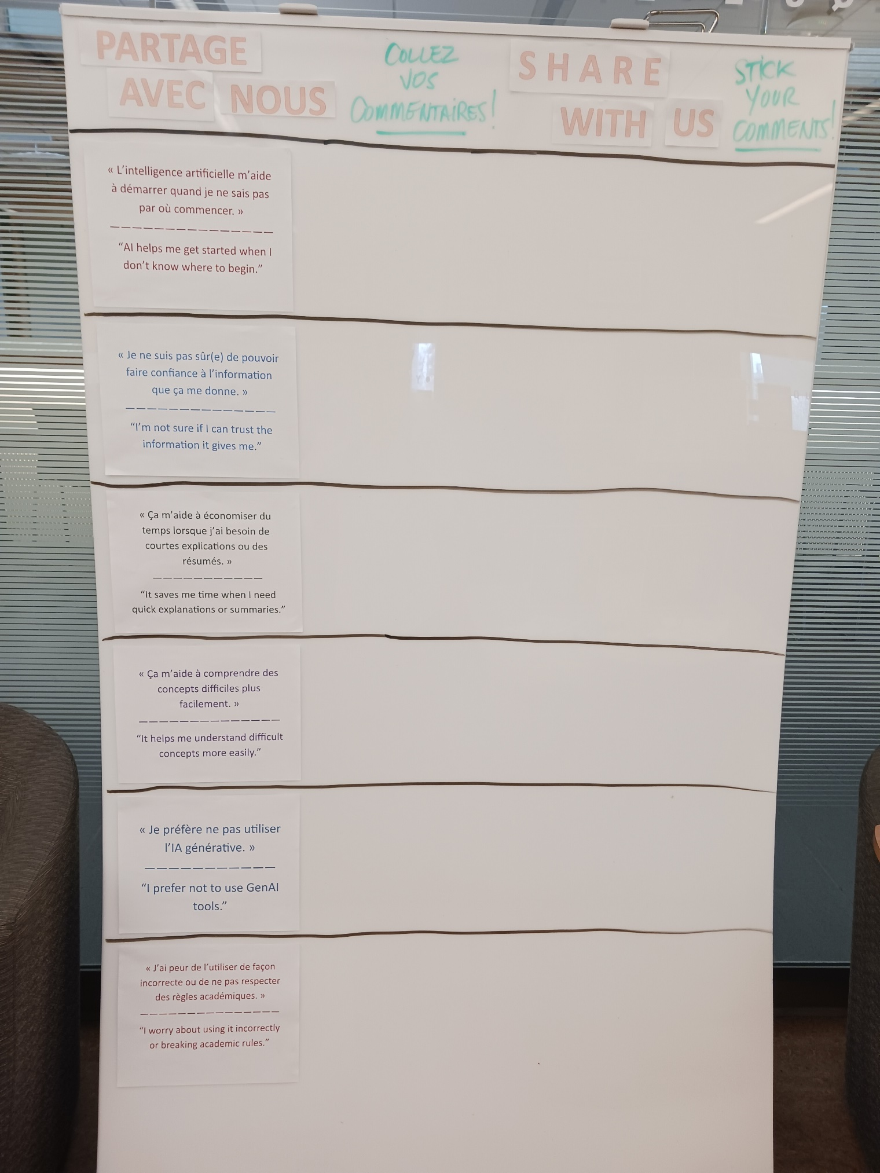
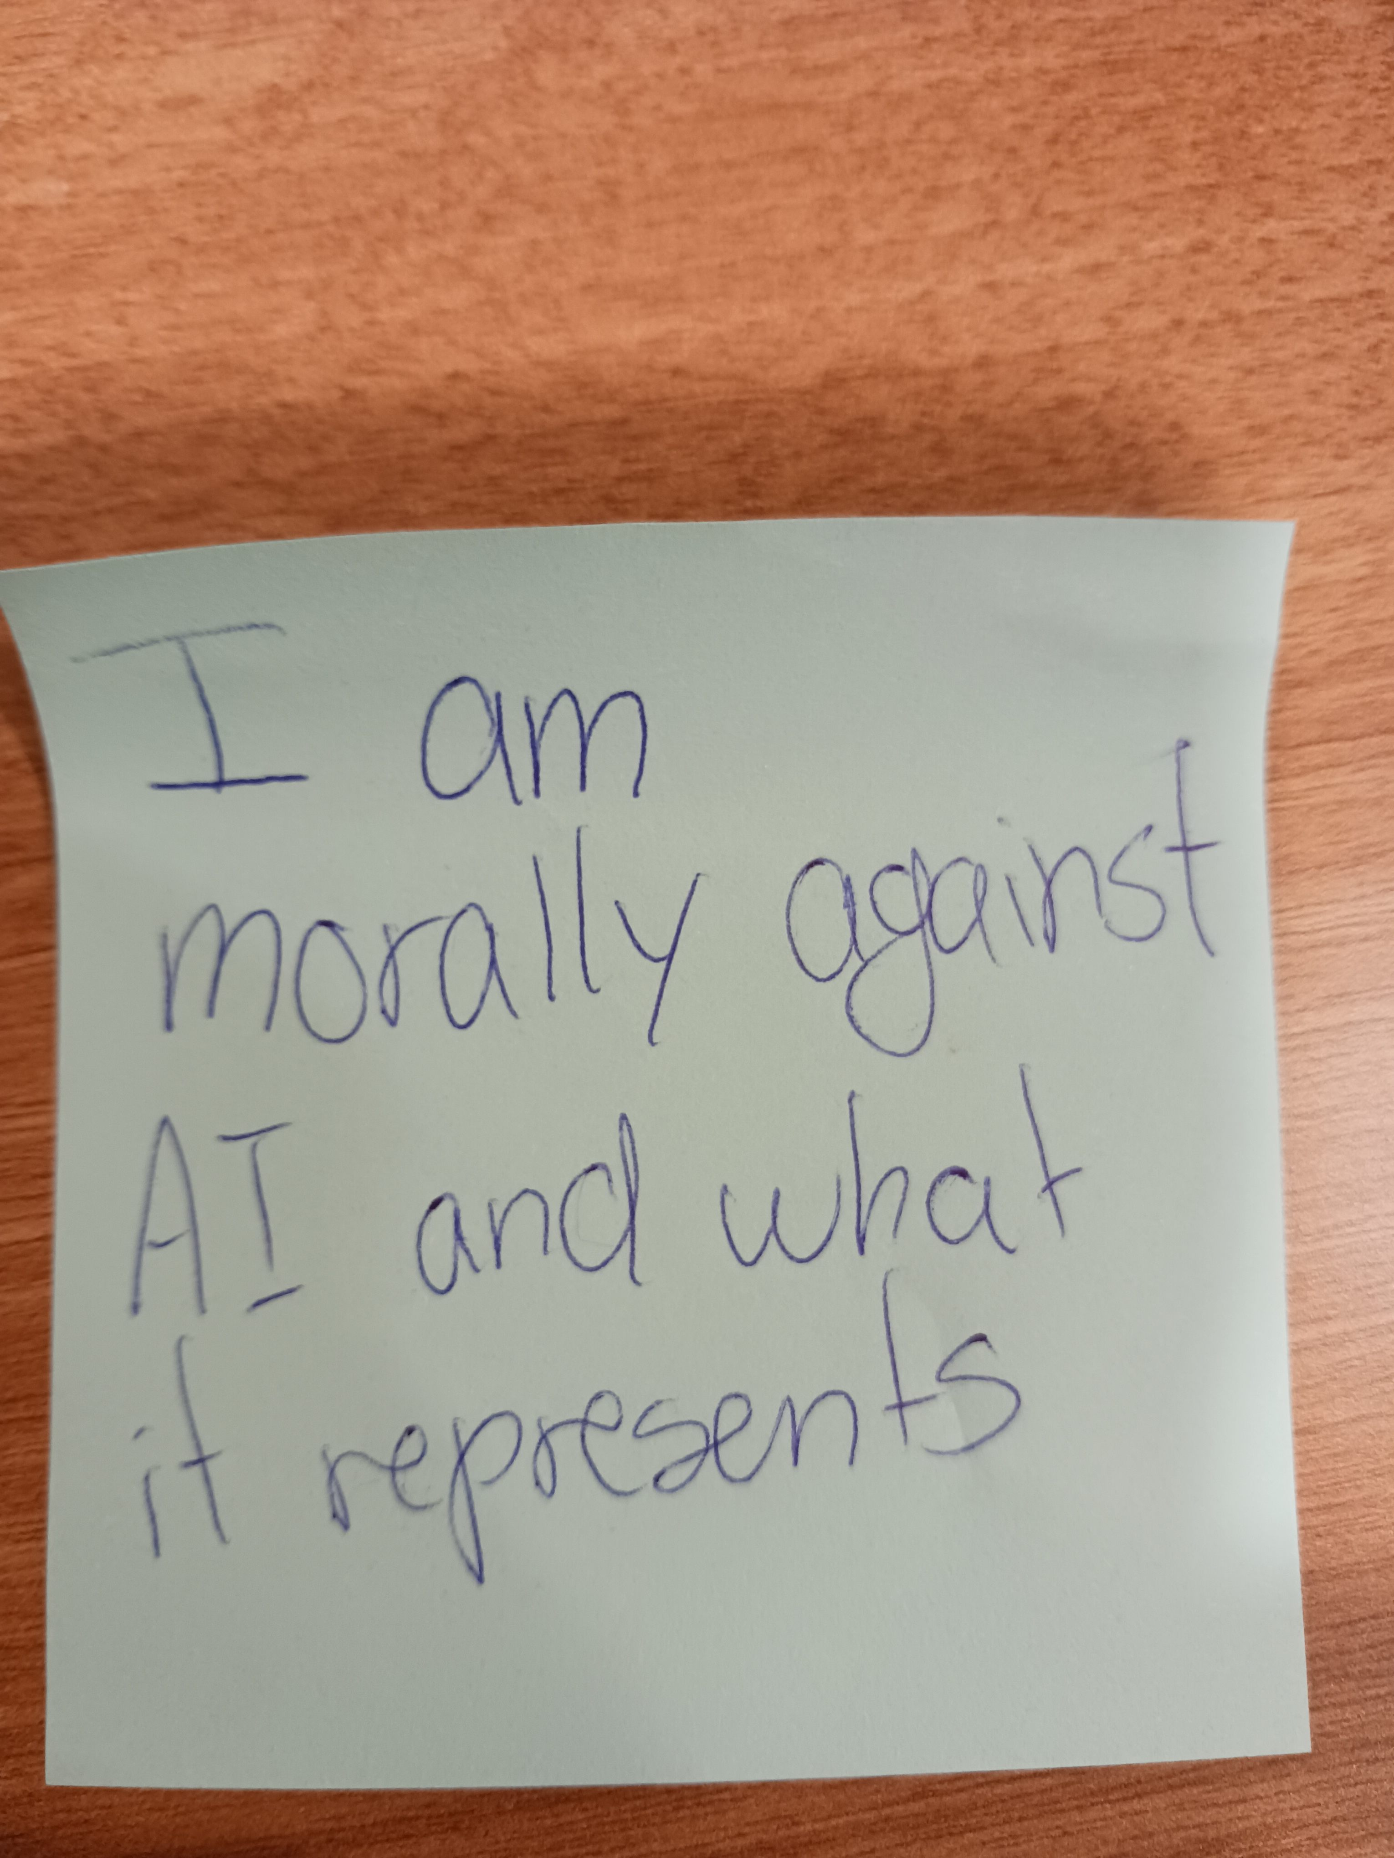
  Whiteboard Activity
MATERIALS & ACTIVITIES

Slide 13
THE TOOLS
  Scopus AI & WoS AI Research Assistant for discovering literature, doing your literature review.
  Microsoft Copilot for support with writing, brainstorming, and planning your research.
  ResearchRabbit for citation mapping and exploring research networks.
  Elicit for summarizing articles and comparing studies.
  NotebookLM for studying, summarizing readings and organizing notes.

Slide 14
KEY QUESTIONS
Is there a university-wide AI policy?
What tools are available through the library website?
Are there any GenAI tools for working with data and statistics?
What tools can I use for doing a literature review?
.

Slide 15
Survey Entries
TOTAL: 7
Français : 3
English: 4

Slide 16
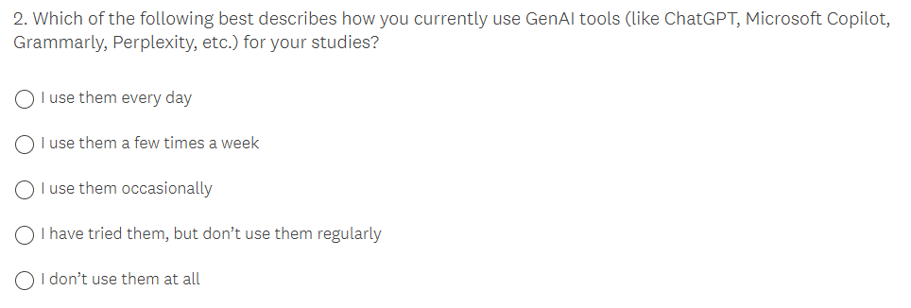
Survey Entries

Slide 17
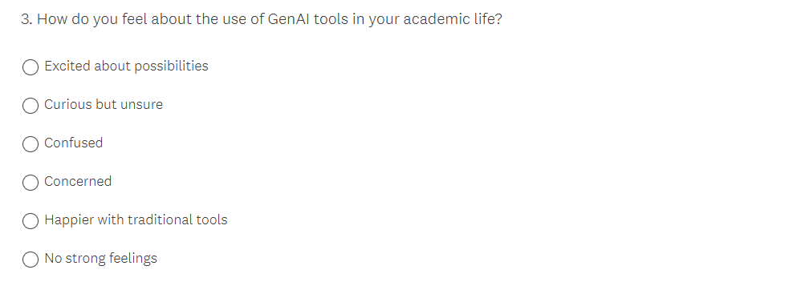
Survey Entries

Slide 18
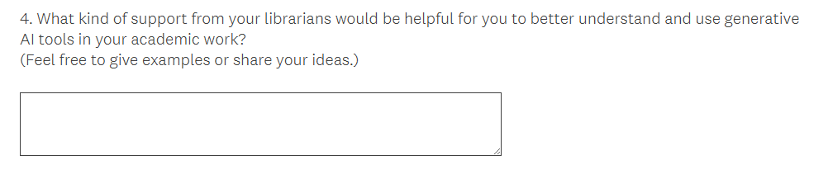
Survey Entries

Slide 19


Survey Entries-Frequency
Survey Entries-Feelings

Slide 20



Survey Entries-Librarian’s Support

Slide 21
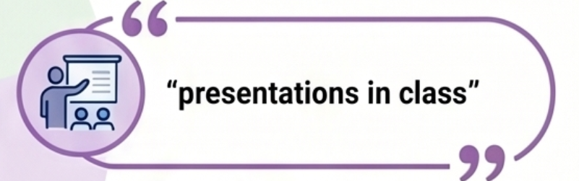
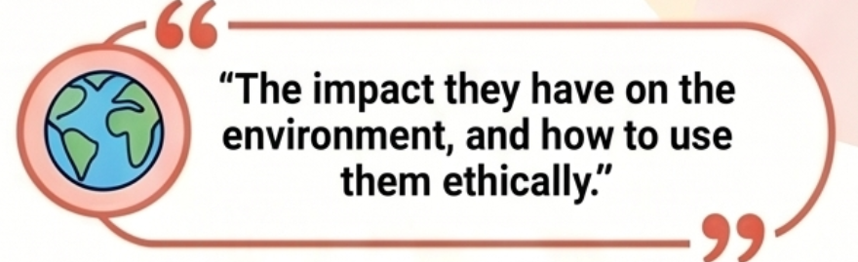
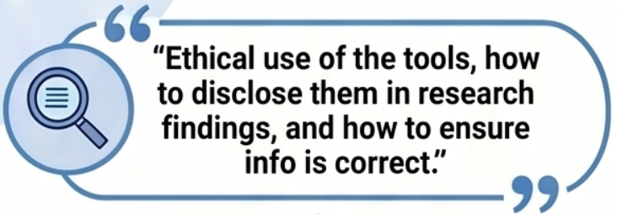
Survey Entries-Librarian’s Support

Slide 22
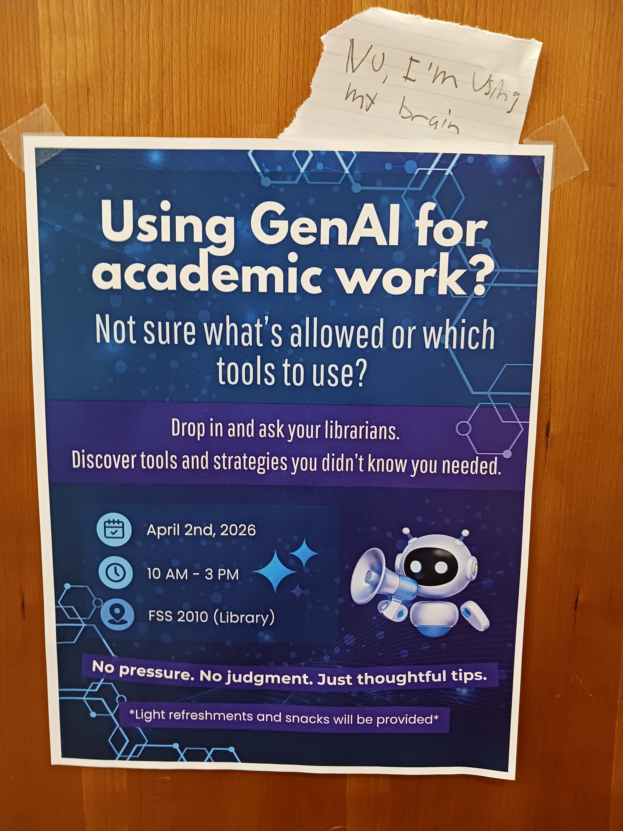
A Student’s Feedback

Slide 23
THANK YOU

