Slide 1



Genie in a bottle?:
AI Generated metadata for digitized documents
Tim Yale
Collection Access, Library of Parliament

Slide 2


Context
What do you want AI to do for you and your metadata?
Plenty of new AI tools out there
Library of Parliament is committed to experimenting with new ways of generating metadata

Slide 3


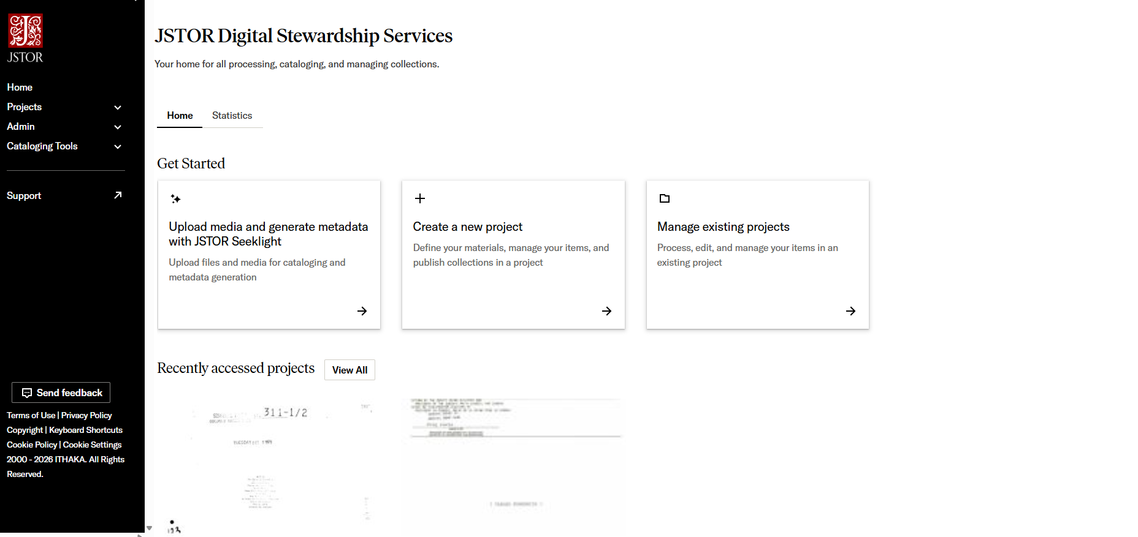
Seeklight
JSTOR product
Uses multiple commercial AI’s to perform different processes on submitted files based on what each is “best at”
Conceived for use with existing archival collections
Generates metadata and transcripts from handwritten text
Describes images
Processes files in bulk

Slide 4
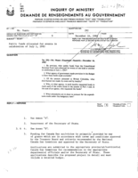
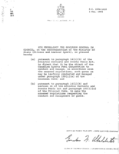
LoP test case
Historical Sessional papers – Documents tabled by the House of Commons originally in print
Response to demand for documents in storage combined with ability to provide public access
Significant number of records already scanned but not described or available to clients.
Work in progress!

Slide 5


Results
Tool creates metadata in Dublin core XML format – needs transforming
Names can be extracted and listed but not authoritative
Subjects are generated but the results are vague
Very fast! Large numbers of files possible
Significant process to make available in catalogue
Easily processed small backlog - Example documents

Slide 6

Conclusions
Tool is interesting but better suited for other purposes
Speed of bulk processing is nice but better with a backlog
Biggest strength is in transcription
Lack of configurability limits institution specific outcomes

Slide 7

Considerations – What do we really want?
Generation vs. Completion
Something vs. Nothing
Language
The Real Genie would be AI tools that are configurable to their needs and that perform tasks that do not require judgement.
Useful tools will require development

