Slide 1
Un guide pratique pour la mise en application des lignes directrices sur l’IA de la bibliothèque
A Practical Guide to Applying Library AI Guiding Principles – Liz Hayden, University of Ottawa
Liz Hayden, uOttawa Library
le 14 mai 2026
L'IA dans les bibliothèques : conversations et connexions dans la capitale
Notes:
Un guide pratique pour la mise en application des lignes directrices sur l’IA de la bibliothèque – Liz Hayden, Université d’Ottawa (bilingue)
La Bibliothèque de l’Université d’Ottawa a conçu un ensemble de lignes directrices sur l’IA qui s’insèreront dans la feuille de route de l’IA de l’Université. Maintenant que les lignes directrices ont été créées, la prochaine étape est de soutenir le personnel afin qu’il comprenne pourquoi elles existent et comment les intégrer dans le travail. Cette conférence éclair présentera ce nouveau guide pratique, qui est en voie d’être déployé.

Slide 2
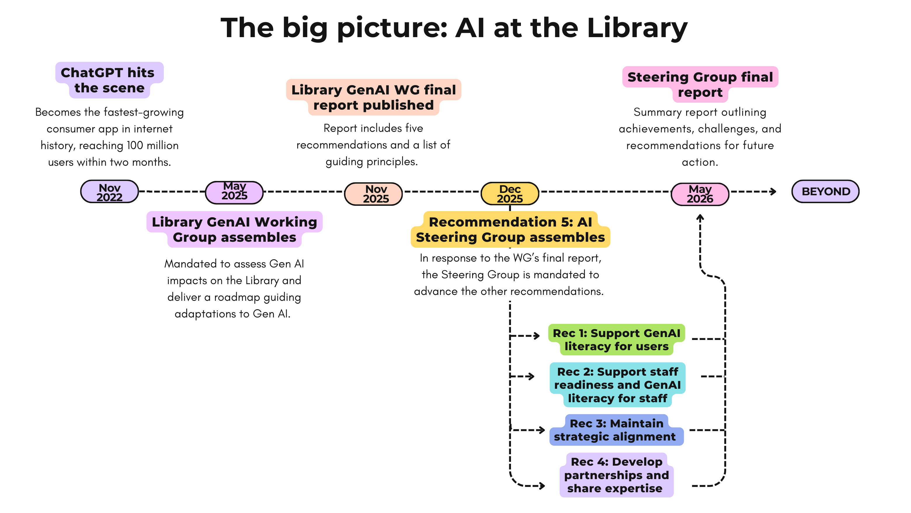

1
Milmo, D. (2023, February 2). ChatGPT reaches 100 million users two months after launch. The Guardian. https://www.theguardian.com/technology/2023/feb/02/chatgpt-100-million-users-open-ai-fastest-growing-app?CMP=share_btn_url
Slide created by Mackenzie Kathmann, uOttawa Library

Slide 3
Principes directeurs
Guiding Principles
Formation sur l’IA generative
Supervision humaine
Utilisation responsable et éthique
Créativité et expérimentation
Inclusion et Accessibilité
Respect de la vie privée
Assurer la transparence
Responsabilité
Fiabilité et validité
Gen AI Literacy
Human Oversight
Responsible & Ethical Use
Creativity & Experimentation
Inclusivity & Accessibility
Respect for Privacy
Uphold Transparency
Ensure Accountability
Ensure Validity & Reliability

Slide 4
The Library AI Guiding Principles Practical Guide
Before you begin, read the Principle and Core idea to understand the expectation
While you work, use the How to apply it section to shape your approach
When you finish, use the Self-assessment questions to review your decisions, check for risks, and confirm that the output is accurate and appropriate.

Slide 5
Principe no. 3
Utilisation responsable et éthique
Principle #3 Responsible and Ethical Use
Principle:
The Library commits to the responsible and ethical adaptation to and use of Gen AI. This includes upholding academic integrity, legal compliance, and the respectful representation of diverse and marginalized voices. Responsible Gen AI use requires active consideration of human and machine biases, and the potential social and environmental impacts of these technologies.

Slide 6
Responsible and Ethical Use Cont’d
Core idea:
Use Gen AI in ways that uphold academic integrity, equity, and legal compliance, while actively mitigating bias, misinformation, and harm. Be open about when, how, and why Gen AI tools are used in our professional work.

Slide 7
Responsible and Ethical Use Cont’d
How to apply it
Consider potential copyright implications before putting your prompt in an AI model (where it often automatically becomes source data).
Minimize unnecessary data processing or excessive generation to minimize environmental impact. AI should improve workflows, not increase workload or produce redundant content.
Review outputs for inclusive and respectful language, especially in public-facing materials. Report any ethically problematic outputs from institutionally supported tools via feedback channels.
Confirm representation of diverse perspectives where appropriate.
For transparency, and to support building trust as we start using AI tools more in our respective work, consider these best practices: document prompts or workflows where appropriate, track versions to distinguish AI-generated drafts from human revisions, and be prepared to explain your rationale for using AI in a workflow. Disclose your use of AI where possible and appropriate under the circumstances and encourage users to do the same.

Slide 8
Responsible and Ethical Use Cont’d
Self-Assessment Questions
Have I asked myself if AI is needed, useful, or the best tool for this particular task? What is the value / impact / risk of using an AI tool in this situation?
Could this use or tool undermine my learning, students’ learning, or the principles of academic integrity?
Have I confirmed my prompt content does not have any copyright or privacy implications?
Have I verified the accuracy of the AI output: including any claims or references? that may reinforce bias or exclude certain communities? for accuracy of the translation? etc.
Have I clearly disclosed when AI contributed or assisted to the work?
Would others be able to reproduce or understand my process with the documentation I produced?

Slide 9
Se conformer aux principes institutionnels
Align with Institutional Principles
6. Respect de la vie privée
« Les modèles et systèmes d’IA doivent incarner la résilience tout en maintenant la confidentialité tout au long de leur cycle de vie. »
La Bibliothèque n’utilise que des outils d’IA générative conformes aux normes et aux protocoles institutionnels en matière de respect de la vie privée. Nous enseignerons les pratiques sécuritaires aux membres du personnel, ainsi qu’aux usagères et usagers.
Principe directeur de TI central
Comment la bibliothèque se conformera au principe de TI central

Slide 10
Se conformer aux principes institutionnels
Align with Institutional Principles
6. Respect for Privacy
Principle:
“AI models and systems must embody resilience while maintaining privacy throughout their entire lifecycle.”
The Library selects Gen AI tools that align with institutional privacy standards and protocols. We will educate staff and users on responsible AI practices.
Principle from Central IT
How the Library will align itself to the Central IT principle

Slide 11
Top 14 Self-Assessment Questions
Training: Have I explored training, tutorials, or communities that could broaden my understanding of generative AI?
General: Have I asked myself if AI is needed, useful, or the best tool for this particular task?
Prompts and Outputs: Is it safe to put this information into an AI prompt? Could the material I’m about to upload contain confidential, proprietary, copyrighted, or operational information that should not be shared with external systems?

Slide 12
Key Component: Examples
Example 1: You have translated a text in DeepL or you have had a Gen AI tool take meeting notes. Before sharing the results with colleagues, will you review the generated content? Yes, always review AI generated results. Things you could miss: Organization names, position titles, department titles, etc. might not have been translated properly or might not reflect the accurate terms used. The generated text may also include terms that are no longer up to date, e.g. are overly gendered or ableist. Consult appropriate style guides to find inclusive terminology to fit that context. Context or tone could be affected in AI output.

Slide 13
Étapes de diffusion
Séance d'info pour l'ensemble du personnel sur les principes directeurs en matière d'IA et présentation du guide à venir
Bulletin d'information du personnel – rubrique régulière, 1 ou 2 principes par numéro
Équipe de direction – atelier pratique pour passer en revue des exemples d'utilisation du guide
Séance de formation sur l'utilisation du guide, ouverte à l'ensemble du personnel (à venir)
Formations ciblées pour des équipes ou des personnes spécifiques (disponibles à partir de juin ; comprend un plan d'intégration des nouveaux employés)

Slide 14
Dissemination steps
All staff information session on the AI Guiding Principles and introduction to upcoming guide
Staff newsletter -regular column, 1 or 2 principles per issue
Leadership team -hands on workshop to run through examples of how to use the guide
Staff month training session open to all staff (upcoming)
Smaller focused training for specific teams/individuals (available beginning in June; includes plan for new staff onboarding)

Slide 15

Liz Hayden ehadyen@uottawa.ca

