Slide 1
Artificial Intelligence and Research Journeys: Insights to Inform Practice
Kari D. Weaver, Program Manager, Artificial Intelligence and Machine Learning, Ontario Council of University Libraries
kari.weaver@ocul.on.ca

Slide 2
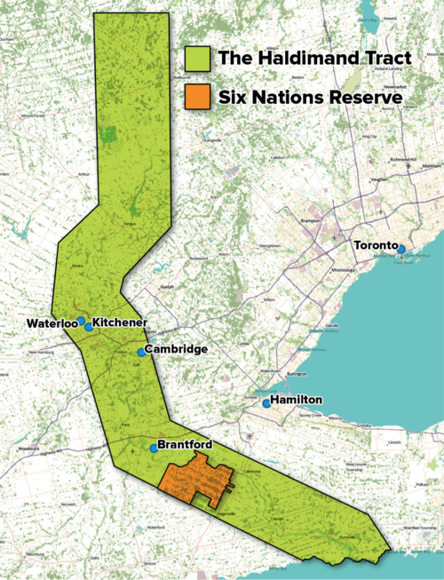
Territorial Acknowledgement
I would like to acknowledge that my work takes place on the traditional territory of the Neutral, Anishinaabeg, and Haudenosaunee peoples. My workplace is situated on the Haldimand Tract, the land granted to the Six Nations that includes six miles on each side of the Grand River.
To learn more about the land you're situated on:
https://native-land.ca/
Image courtesy of Waterloo Public Library

Slide 3
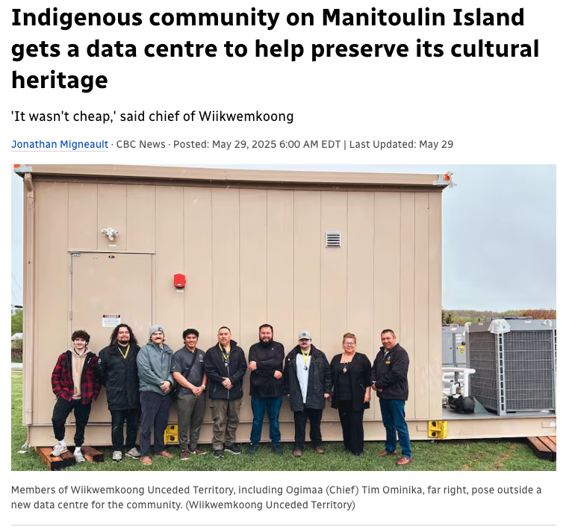
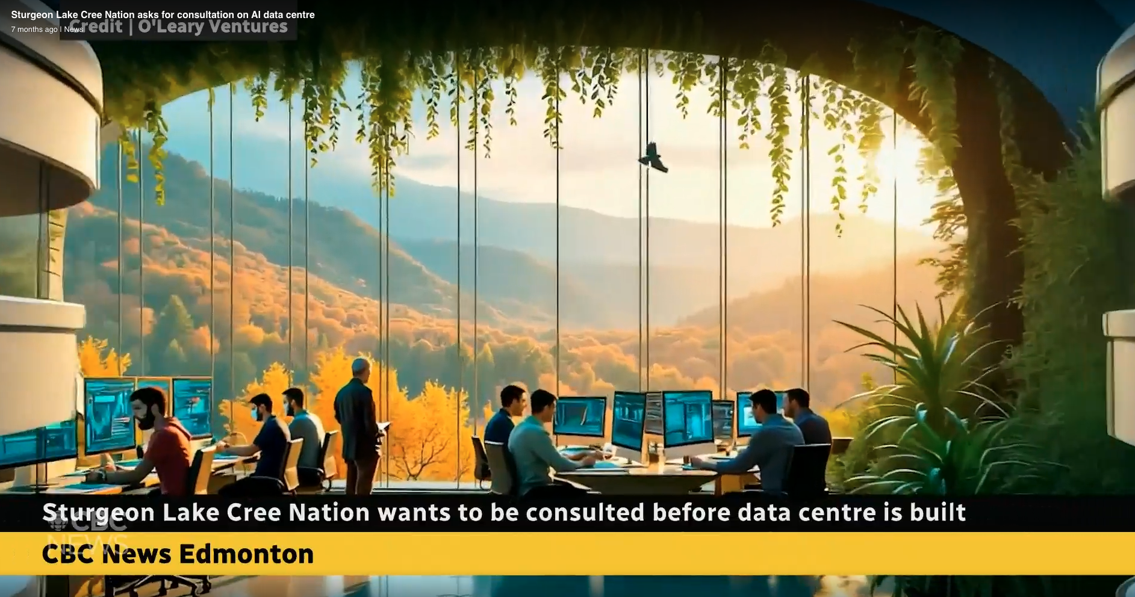
Land, Water, and Data Sovereignty
A proposed northern Alberta AI Data Center, without Indigenous consultation (Learn more from Alberta First Nation voices 'grave concern')
An Indigenous Data center to preserve cultural heritage (Learn more on the Indigenous community on Manitoulin Island gets a data centre )
Learn more about Data Sovereignty

Slide 4
Today’s Agenda
The research journey
AI and Research: Where are we now?
How we define different AI systems used in research
Uses and level of familiarity of scholars with AI in research
Two case studies of current researchers and their AI use
Implications for libraries
Returning to the research journey

Slide 5
Understanding the Research Journey
(Samson et al., 2022) adapted from Vintage cartoon map titled ‘The island of
research

Slide 6
Research Tasks
Idea generation
Hypothesis development
Literature search
Literature summarization
Design > Study design / experiment design
Design > Data collection methodology
Design > Data analysis plan
Data collection (operations / activities)
Data creation
Computer code generation/auditing
Data cleaning/preprocessing/auditing
Quantitative data analysis
Qualitative data analysis
Data visualization
Figure or image generation
Drafting manuscript or abstract text
Translation
Editing or rewriting including of reference lists
(Weaver et al. 2026)

Slide 7
Setting the Context: AI and Research
AI is being used across disciplines to accelerate scientific discovery (Madanchian & Taherdoost, 2025; Soochan, 2024)
AI-based work is helping surface new patterns or relationships in big data that would previously go unrecognized (The Royal Society, 2024)
However, it has resulted in a narrowing of scientific focus in fields like natural sciences (Hao et al., 2026)
Concerns have been broadly raised about transparency and reproducibility of AI-based research (Munn, 2025)

Slide 8
What do we mean when we say AI?
Symbolic logic (Good Old Fashioned AI)
Machine Learning (classifiers, neural networks, etc.)
Deep learning (deep neural networks)
Generative AI (LLM’s, image/audio/video generation, agents)

Slide 9
What is Agentic AI?
Generative AI (LLM’s) | Agentic AI (LLM + “harness”)
Input to user -> output to user | Runs LLM in a loop (feeds output back into input)
Context window only | Context window + memory
Tools can be connected through additional software (MCP’s, etc.) | Tools already built-in (file access, plugins, web search, etc.)
Single conversation | Full workflow (Plan -> Design -> Implement)
ChatGPT, Claude, Gemini, Copilot | ChatGPT Codex, Claude Code, Claude Cowork, OpenClaw
Operation
Memory
Capabilities
Scope of work
Examples

Slide 10
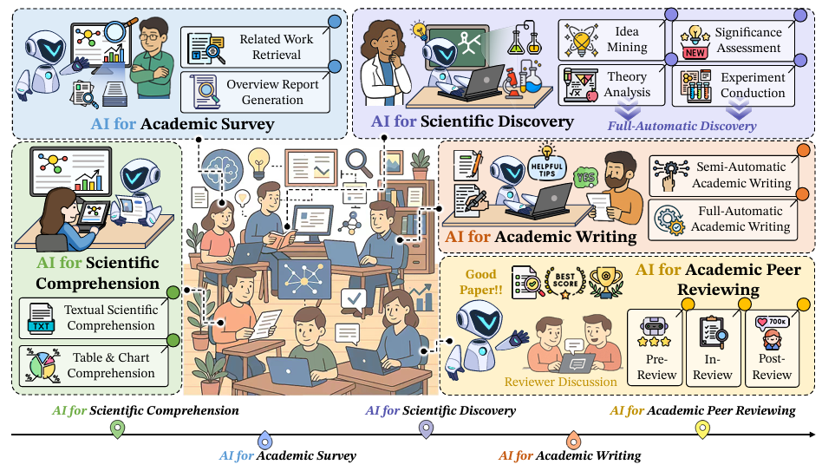
Classifying AI Use in Academic Research
(AI4Research - Chen et al. 2025)

Slide 11
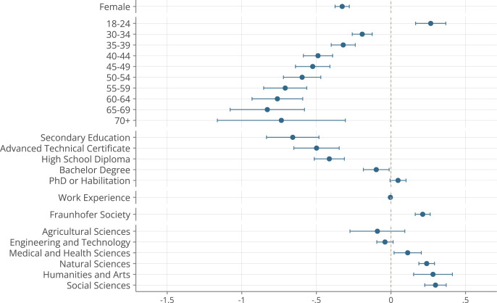
How Familiar are Researchers with AI?
OLS regression on question “How familiar are you with AI tools” with a six-point scale (mean 4.4):
“Do not know”
“I do not know any AI tools”,
“I never used AI tools but heard of them”,
“I used AI tools a few times”,
“Rather familiar”,
“Very familiar”.
The dashed vertical line indicates the reference group for mutually exclusive characteristics – gender (male), age group (25–29), highest education level (Master’s degree), and organization (MPS).
(Chugunova et al. 2026)

Slide 12
The Case Studies

Slide 13
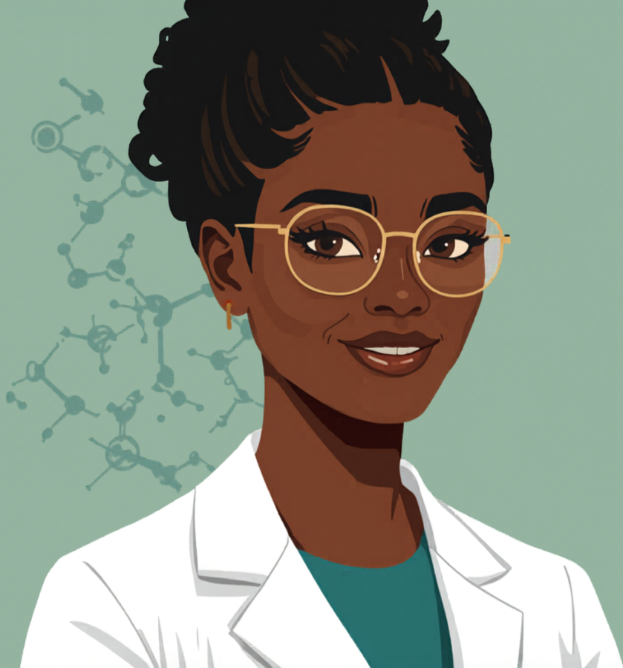
Case Study 1: Laurel
A theoretical physicist
Originally from a Francophone country in Africa, now working at an English speaking research university in Canada
A relatively new faculty member, only 2 years beyond the postdoc
Not yet tenured
Image by Canva AI

Slide 14
Laurel’s Research Tasks
Idea generation
Hypothesis development
Literature search
Literature summarization
Design > Study design / experiment design
Design > Data collection methodology
Design > Data analysis plan
Data collection (operations / activities)
Data creation
Computer code generation/auditing
Data cleaning/preprocessing/auditing
Quantitative data analysis
Qualitative data analysis
Data visualization
Figure or image generation
Drafting manuscript or abstract text
Translation
Editing or rewriting including of reference lists
(Weaver et al. 2026)

Slide 15

Laurel’s Process
Relies on many AI tools for research:
  Perplexity for discovery and mapping of sources
  ChatGPT Free for coding (then cleanup by hand)
  Dall-E and ChatGPT for image generation
  Copilot (institutional license) for data analysis for data with sensitive information
  ChatGPT for translation and editing (unconcerned with her material being used for training data)
Image by ChatGPT

Slide 16
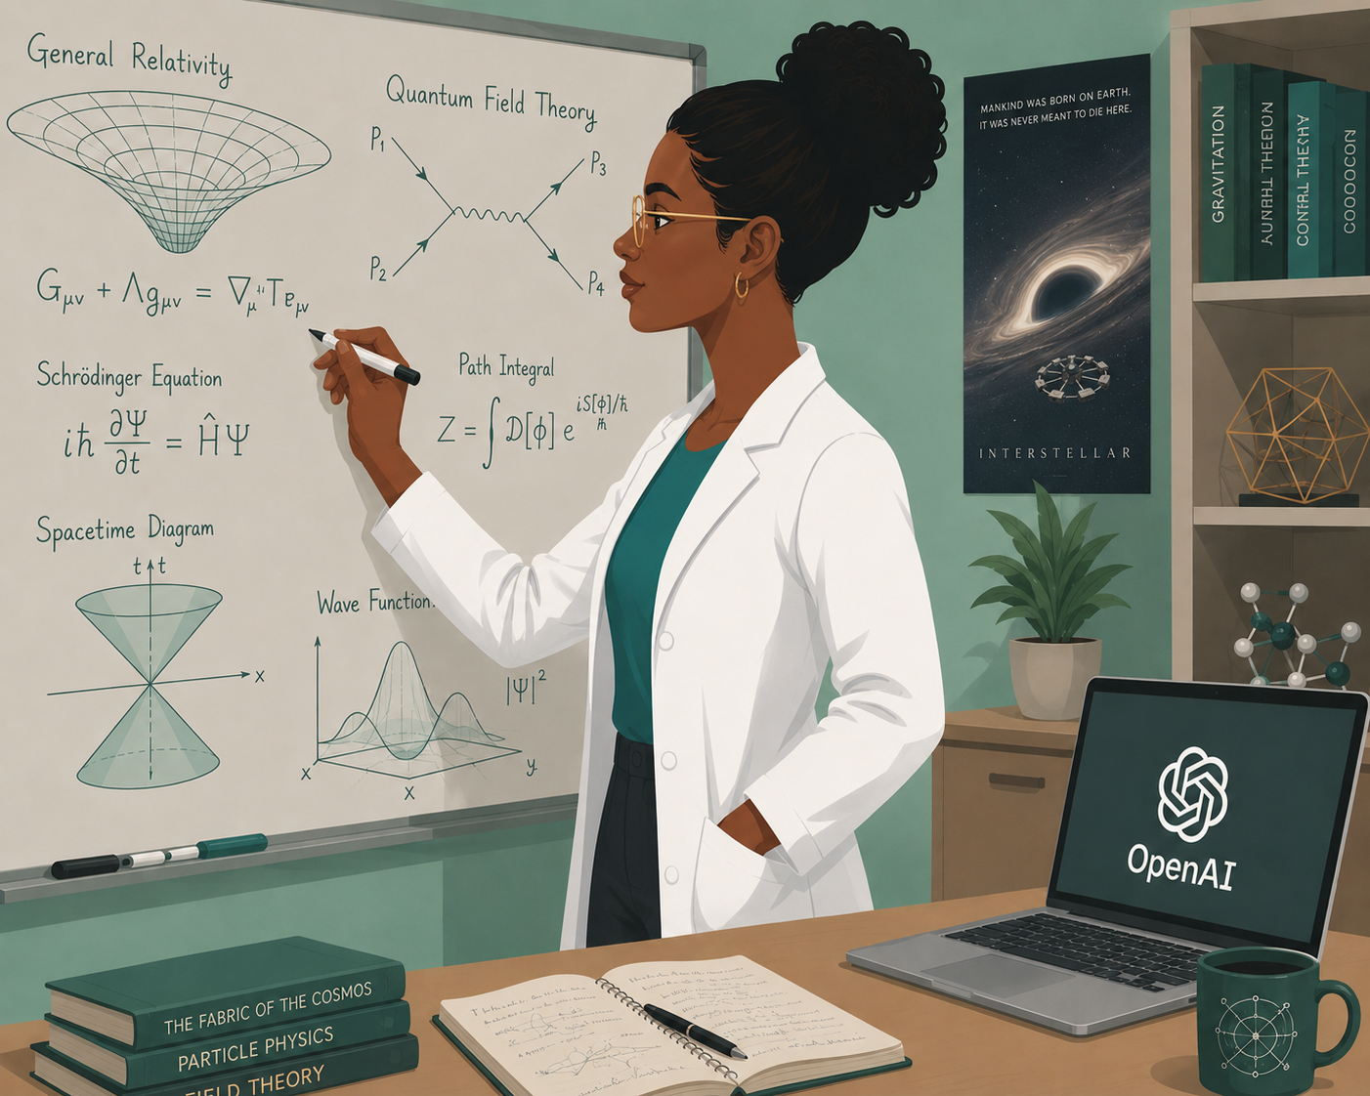
Laurel’s Process
Occasionally tries other AI tools
Keeps coming back to ChatGPT due to simplicity
Uses her own knowledge to close gaps.
Image by ChatGPT

Slide 17

Case Study 2: David
A business management professor
Mid-career researcher with tenure
Works at an English language university in Southeast Asia
Image by Canva AI

Slide 18
David’s Research Tasks
Idea generation
Hypothesis development
Literature search
Literature summarization
Design > Study design / experiment design
Design > Data collection methodology
Design > Data analysis plan
Data collection (operations / activities)
Data creation
Computer code generation/auditing
Data cleaning/preprocessing/auditing
Quantitative data analysis
Qualitative data analysis
Data visualization
Figure or image generation
Drafting manuscript or abstract text
Translation
Editing or rewriting including of reference lists
(Weaver et al. 2026)

Slide 19

David’s Process
Relies heavily on Claude Cowork subscription (covered by grant funds) + ChatGPT Codex subscription (institutional license)
Uses Claude Cowork to:
  Access local files for concepts, interesting notes, research ideas
  Generate hypotheses, complete ethics applications, design data collection instruments, collect data (depending on kind of study)
  Cleaning/anonymizing transcripts in cases where it can’t do direct data collection
  With ChatGPT Codex, build code for statistical analysis, then run the analysis (Python, sometimes other languages)
  For data in non-English languages, translations
  Literature reviews, summaries, some manuscript writing, and reference formatting
  Cowork plugins for Microsoft applications (Word, Excel, Powerpoint) help enhance and streamline dissemination
Image by ChatGPT

Slide 20
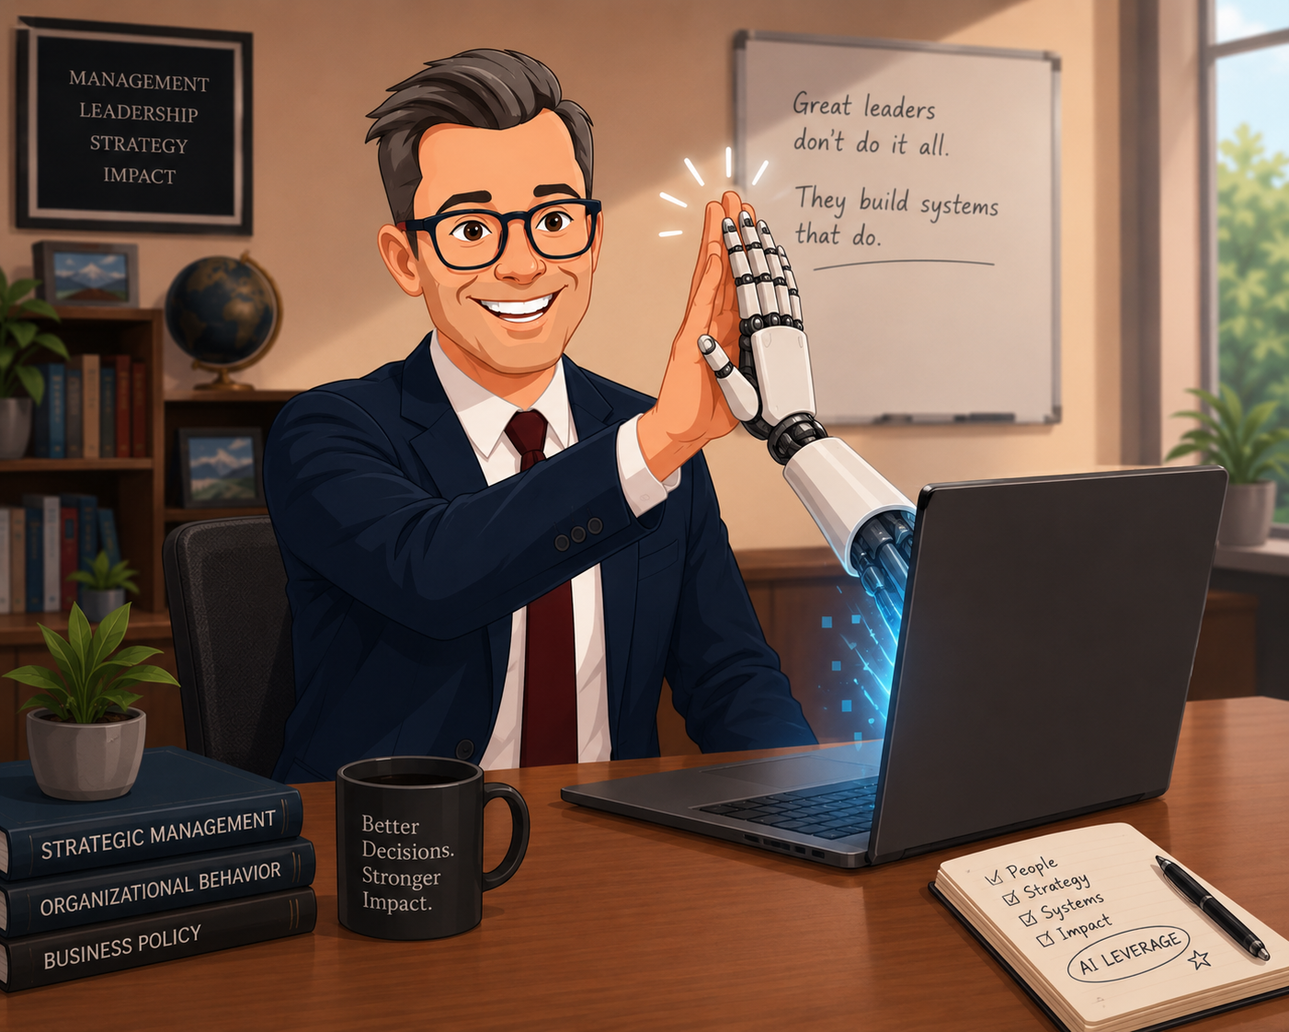
David’s Process
“AI is my best research assistant”
Not a fully automatic workflow yet:
  Uses Cowork heavily enough that he usually runs out of tokens
  Must validate the output, and often finds points for revision (Cowork gets it 95% right, David gets it to 100%)
Image by ChatGPT

Slide 21
Laurel’s Process vs David’s Process
Primary concern: continued growth and skill development.
  Wants to balance speed with growth – particularly important as new scholar.
Primary concern: maintaining quality with integrity
  Still wants to leverage flexibility and speed of AI.

Slide 22
The Changing Landscape
Today, a lot of researchers’ AI use reflects Laurel’s process
However, as time goes on, more researchers’ AI use will look like David

Slide 23
Where do Libraries Belong in a World of AI-driven Research?
Do libraries act solely as repositories of knowledge/data,
with all research functions carried out by AI and the researcher?
OR
Do libraries and library workers enable the research process alongside AI and the researcher?

Slide 24
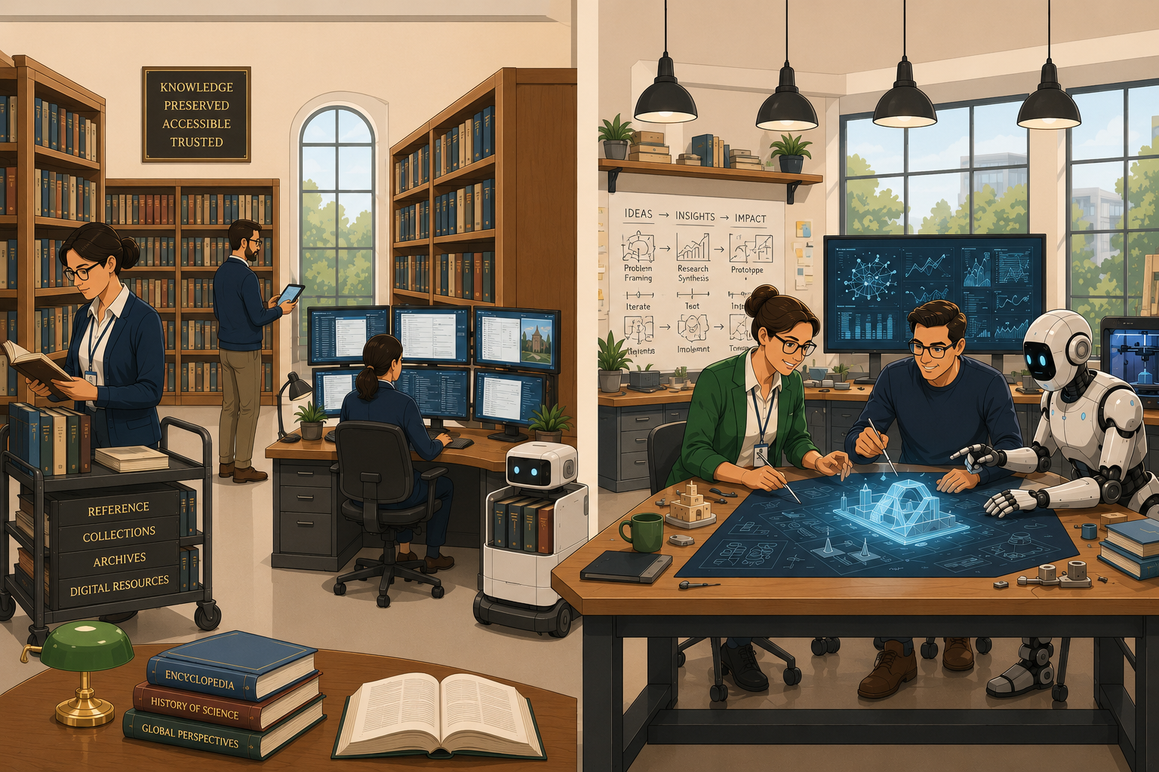
The Warehouse vs. The Workshop
Image by ChatGPT

Slide 25
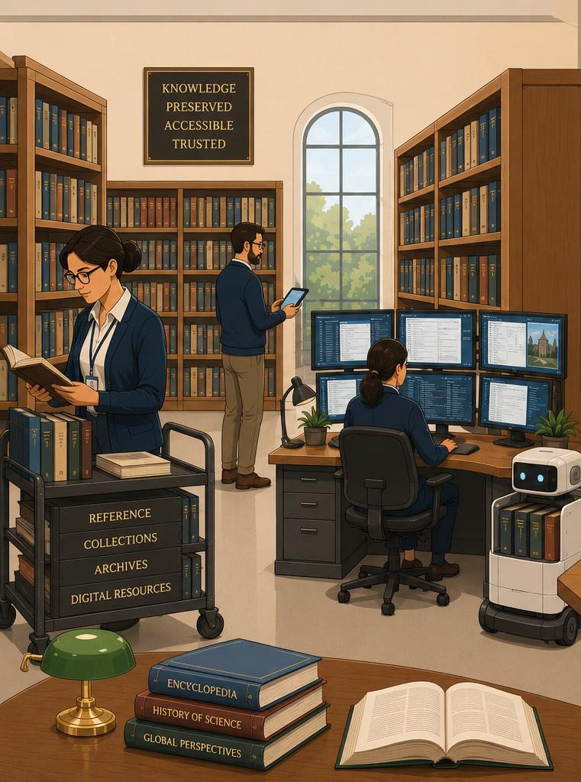
Where do Libraries Belong in a World of AI-driven Research?: The Warehouse
Libraries as warehouses
  Focus on unique collections
  Understand how to make licensed content available for AI-enabled workflows
  Emphasize expertise in metadata, structured data
  Develop expertise to connect library data systems with researchers’ AI tools
Image by ChatGPT

Slide 26
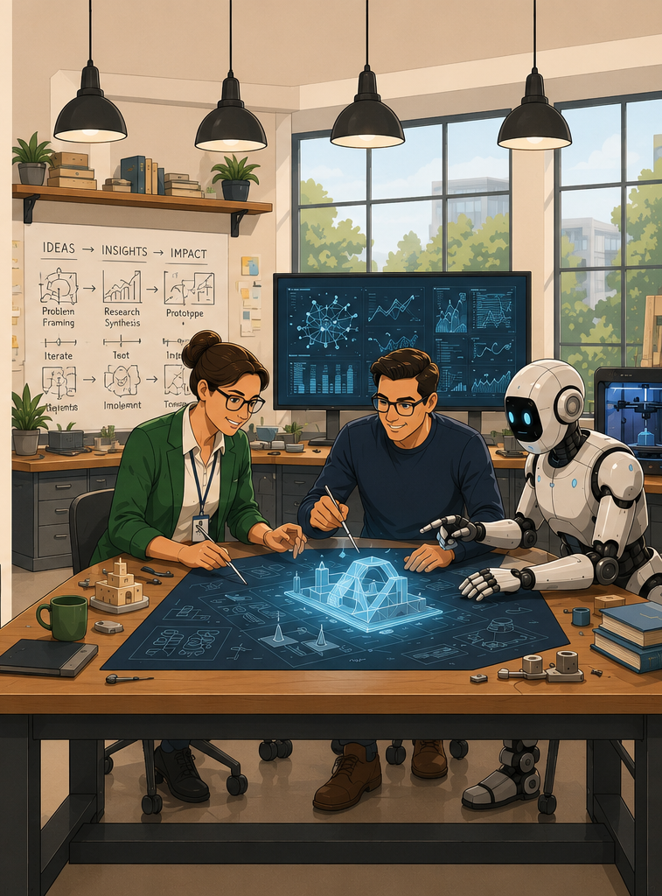
Where do Libraries Belong in a World of AI-driven Research?: The Workshop
Libraries as workshops
  All of the above, plus:
  Becoming familiar with using and creating AI agents
  Training researchers to use AI
  Expertise in evaluation and validation
  Must bridge digital divide (hardware and software)
Image by ChatGPT

Slide 27
Future of Research Journey
Free tools because of budget constraints
More elements of the research journey completed by AI, so it appears shorter
Movement toward agentic team workspaces/workflows
Leverage 1-2 expensive tools because costs are covered
Researchers will need to level up their AI skills and knowledge
Needs for better validation processes and checks

Slide 28
References
Chen, Q., Yang, M., Qin, L., Liu, J., Yan, Z., Guan, J., Peng, D., Ji, Y., Li, H., Hu, M., Zhang, Y., Liang, Y., Zhou, Y., Wang, J., Chen, Z., & Che, W. (2025). AI4Research: A Survey of Artificial Intelligence for Scientific Research. arXiv. https://doi.org/10.48550/ARXIV.2507.01903
Chugunova, M., Harhoff, D., Hölzle, K., Kaschub, V., Malagimani, S., Morgalla, U., & Rose, R. (2026). Who uses AI in research, and for what? Large-scale survey evidence from Germany. Research Policy, 55(2), 105381. https://doi.org/10.1016/j.respol.2025.105381
Hao, Q., Xu, F., Li, Y., & Evans, J. (2026). Artificial intelligence tools expand scientists’ impact but contract science’s focus. Nature, 649(8099), 1237–1243. https://doi.org/10.1038/s41586-025-09922-y
Madanchian, M., & Taherdoost, H. (2025). The impact of artificial intelligence on research efficiency. Results in Engineering, 26, 104743. https://doi.org/10.1016/j.rineng.2025.104743

Slide 29
References
Munn, J. (2025, October 29). The Reproducibility Crisis in Machine Learning: A Reckoning, A Reset. Medium. https://medium.com/@johnmunn/the-reproducibility-crisis-in-machine-learning-a-reckoning-a-reset-6edac20cdd34
Samson, S., Hutchings, C., Goolam Hoosen, T., & Thesen, L. (2022). ‘I am everywhere all at once’: pipelines, rhizomes and research writing. Higher Education, 83, 1207–1223. https://doi.org/10.1007/s10734-021-00738-z
Soochan, P. (2024). The Effect of AI on Research. Association for Women in Science. AWIS. https://awis.org/resource/effect-ai-research/
The Royal Society. (n.d.). Science in the age of AI: How artificial intelligence is changing the nature and method of scientific research. Retrieved royalsociety.org/science-in-the-age-of-ai
Weaver, K. D., Seghers, B., & Perkins, M. (2026). Focus Track: Toward an AI Disclosure Standard in Scholarly Publishing. World Conference on Research Integrity. Vancouver, Canada, May 3-6.

Slide 30
Questions? Comments?
Please reach out kari.weaver@ocul.on.ca

